Slide 1
Getting Started with Python
Week 1

Slide 2
Overview: Python
Python is a scripting language like Perl, R, PHP
Python is easy to install, and can be installed on different operating systems (Windows, Mac or Linux)
Ideal for text and data processing, it offers powerful libraries for computation using large-scale data
Nowadays, python-based software and tools (e.g. PyTorch) are being heavily used in machine and deep learning and AI solutions

Slide 3
Overview: Python
Note that Python is constantly evolving We will using the latest version of Python Beware:
⁾ Python 2 was in use from 2000. Python 3 is in use since 2008.
⁾ Python follows a yearly release cycle. New versions come out in autumn and are usually supported for 3 to 4 years.

Slide 4
Overview: Jupyter Notebook
Jupyter has support for over 40 different programming languages and Python is one of them. Python is a requirement for installing the Jupyter Notebook itself.
Jupyter Notebook is an open-source web application that allows you to create and share documents that contain live code, equations, visualizations, and narrative text. It is also used for data cleaning and transformation, numerical simulation, statistical modeling, data visualization, machine learning, and much more.

Slide 5
Installing Anaconda
Anaconda is a free and open source distribution of the Python programming languages for data science and machine learning related applications (large-scale data processing, predictive analytics, scientific computing), that aims to simplify package management and deployment
Anaconda contains Jupyter.
Open https://docs.anaconda.com/anaconda/install/ Python libraries included in Anaconda include NumPy, pandas, etc You can install it in Windows / Mac / Linux

Slide 6
Starting with Jupyter Notebook
Open Jupyter Notebook [type in Windows start menu] Once opened, you can see Notebook Dashboard
Dashboard will show you only to the files and sub-folders contained within Jupyter’s start-up directory
In Linux you can launch Jupyter Notebook by jupyter notebook

Slide 7
Starting with Jupyter Notebook
Click the “New” drop-down button in the top-right and select “Python 3”
“New” → Python 3

Slide 8
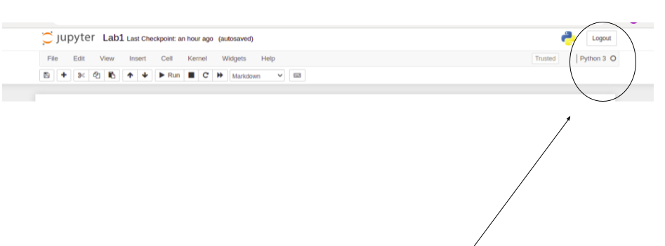
test.ipynb

Slide 9
Starting with Jupyter Notebook
Then Jupyter Notebook will open in new tab You will see the new file Untitled.ipynb Change the name of the file, say with test
test.ipynb file is a text file that describes the contents of your notebook in a format called JSON

Slide 10
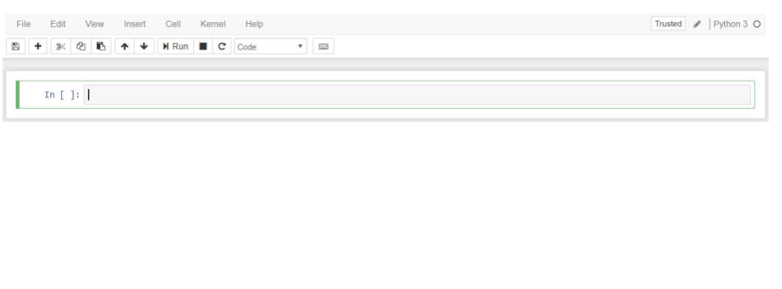
test.ipynb

Slide 11
Starting with Jupyter Notebook
A kernel is an engine that executes the code contained in a notebook document (e.g. test.ipynb)
A cell is a container for text (code) to be displayed in the notebook Code to be executed by the notebook’s kernel
Type in cell: print ("This is my first code in Python") To execute this code; press Run button

Slide 12
Starting with Jupyter Notebook
When you press button Run, you run the code in cell, i.e. print ("This is my first code in Python")
Thereafter, program’s output is displayed below and the label to its left will have changed from In [ ] to In [1]
The label number indicates when the cell was executed on the kernel – in your case the cell was executed once
If you execute the code of that cell again (press Run again), the label number will be [2] and so on ...
You can click Insert and select Insert Cell Below to create a new code cell
You can delete a cell from Edit and Delete Cell

Slide 13
Starting with Python
Python.org https://www.python.org/
Python Tutorials:
https://docs.python.org/3.8/tutorial/index.html
Python Tutorials jupyter.org
Jupyter Notebook Documentation:
https://jupyter-notebook.readthedocs.io/en/stable

